Slide 1
HIVE
A warehouse solution
over
map-reduce framework
Dony Ang
Ashish Thusoo, Joydeep Sen Sarma, Namit Jain, Zheng Shao,
Prasad Chakka, Suresh Anthony, Hao Liu, Pete Wyckoff and Raghotham Murthy

Slide 2
overview
background
what is Hive
Hive DB
Hive architecture
Hive datatypes
hiveQL
hive components
execution flows
compiler in details
pros and cons
conclusion

Slide 3
background
Size of collected and analyzed datasets for business intelligence is growing rapidly, making traditional warehousing more $$$
Hadoop is a popular open source map-reduce as an alternative to store and process extremely large data sets on commodity hardware
However, map reduce itself is very low-level and required developers to write custom code.

Slide 4
General Ecosystem of DW
Reporting / BI layer
SQL
Hadoop
M / R
M / R
SQL
ETL

Slide 5
what is hive ?
Open-source DW solution built on top of Hadoop
Support SQL-like declarative language called HiveQL which are compiled into map-reduce jobs executed on Hadoop
Also support custom map-reduce script to be plugged into query.
Includes a system catalog, Hive Metastore for query optimizations and data exploration

Slide 6
Hive Database
Data Model
Tables
Analogous to tables in relational database
Each table has a corresponding HDFS dir
Data is serialized and stored in files within dir
Support external tables on data stored in HDFS, NFS or local directory.
Partitions
@table can have 1 or more partitions (1-level) which determine the distribution of data within subdirectories of table directory.

Slide 7
HIVE Database cont.
e.q : Table T under /wh/T and is partitioned on column ds + ctry
For ds=20090101
ctry=US
Then data is stored within dir /wh/T/ds=20090101/ctry=US
Buckets
Data in each partition are divided into buckets based on hash of a column in the table. Each bucket is stored as a file in the partition directory.

Slide 8
HIVE datatype
Support primitive column types
Integer
Floating point
Strings
Date
Boolean
As well as nestable collections such as array or map
User can also define their own type programmatically

Slide 9
Data Units
Databases.
Tables.
Partitions.
Buckets (or Clusters)..
Notes:
In the order of granularity - Hive data is organized into:
*Databases: Namespaces that separate tables and other data units from naming confliction.
*Tables: Homogeneous units of data which have the same schema.
*Partitions: Each Table can have one or more partition Keys which determines how the data is stored. Partitions - apart from being storage units - also allow the user to efficiently identify the rows that satisfy a certain criteria. For example, a date_partition of type STRING and country_partition of type STRING. Each unique value of the partition keys defines a partition of the Table. You can run that query only on the relevant partition of the table thereby speeding up the analysis significantly. Partition columns are virtual columns, they are not part of the data itself but are derived on load.
*Buckets (or Clusters): Data in each partition may in turn be divided into Buckets based on the value of a hash function of some column of the Table. These can be used to efficiently sample the data.

Slide 10
Type System
Primitive types
Integers:TINYINT, SMALLINT, INT, BIGINT.
Boolean: BOOLEAN.
Floating point numbers: FLOAT, DOUBLE .
String: STRING.
Complex types
Structs: {a INT; b INT}.
Maps: M['group'].
Arrays: ['a', 'b', 'c'], A[1] returns 'b'.

Slide 11
Examples – DDL Operations
CREATE TABLE sample (foo INT, bar STRING) PARTITIONED BY (ds STRING);
SHOW TABLES '.*s';
DESCRIBE sample;
ALTER TABLE sample ADD COLUMNS (new_col INT);
DROP TABLE sample;
Notes:
*Creates a table called invites with two columns and a partition column called ds. The partition column is a virtual column. It is not part of the data itself but is derived from the partition that a particular dataset is loaded into. By default, tables are assumed to be of text input format and the delimiters are assumed to be ^A(ctrl-a).
*lists all the table that end with 's'. The pattern matching follows Java regular expressions.

Slide 12
Examples – DML Operations
LOAD DATA LOCAL INPATH './sample.txt' OVERWRITE INTO TABLE sample PARTITION (ds='2012-02-24');
LOAD DATA INPATH '/user/falvariz/hive/sample.txt' OVERWRITE INTO TABLE sample PARTITION (ds='2012-02-24');
Notes:
*Loads a file that contains two columns separated by ctrl-a into sample table. 'local' signifies that the input file is on the local file system. If 'local' is omitted then it looks for the file in HDFS.
*The keyword 'overwrite' signifies that existing data in the table is deleted. If the 'overwrite' keyword is omitted, data files are appended to existing data sets.
*The second command will load data from an HDFS file/directory to the table. Note that loading data from HDFS will result in moving the file/directory. As a result, the operation is almost instantaneous.

Slide 13
SELECTS and FILTERS
SELECT foo FROM sample WHERE ds='2012-02-24';
INSERT OVERWRITE DIRECTORY '/tmp/hdfs_out' SELECT * FROM sample WHERE ds='2012-02-24';
INSERT OVERWRITE LOCAL DIRECTORY '/tmp/hive-sample-out' SELECT * FROM sample;
Notes:
*selects column 'foo' from all rows of partition ds=2012-02-24 of the invites table. The results are not stored anywhere, but are displayed on the console.
*selects all rows from partition ds=2012-02-24 of the invites table into an HDFS directory. The result data is in files (depending on the number of mappers) in that directory. NOTE: partition columns if any are selected by the use of *. They can also be specified in the projection clauses.
*the last query store the result into a local directory.

Slide 14
hiveQL
Support SQL-like query language called HiveQL for select,join, aggregate, union all and sub-query in the from clause
Support DDL stmt such as CREATE table with serialization format, partitioning and bucketing columns
Command to load data from external sources and INSERT into HIVE tables.
LOAD DATA LOCAL INPATH ‘/logs/status_updates’
INTO TABLE status_updates PARTITION (ds=‘2009-03-20’)
DO NOT support UPDATE and DELETE

Slide 15
hiveQL cont.
Support multi-table INSERT
FROM (SELECT a.status, b.schoold, b.gender
FROM status_updates a JOIN profiles b
ON (a..userid = b.userid)
and a.ds=‘2009-03-20’)
) subq1
INSERT OVERWRITE TABLE gender_summary PARTITION (ds=‘2009-03-20’)
SELECT subq1.gender,COUNT(1) GROUP BY subq1.gender
INSERT OVERWRITE TABLE school_summary PARTITION (ds=‘009-03-20’)
SELECT subq.school, COUNT(1) GROUP BY subq1.school
Also support User-defined column transformation (UDF) and aggregation (UDAF) function written in Java

Slide 16
Aggregations and Groups
SELECT MAX(foo) FROM sample;
SELECT ds, COUNT(*), SUM(foo) FROM sample GROUP BY ds;
FROM sample s INSERT OVERWRITE TABLE bar SELECT s.bar, count(*) WHERE s.foo > 0 GROUP BY s.bar;
Notes:
*The first query get the max value of foo.
*The 2nd query groups the ds, sums the foo values for a given ds and count the amount of row for the given ds.
*The last one show us how we can insert the ouptup into a table.

Slide 17
Join
CREATE TABLE customer (id INT,name STRING,address STRING)
ROW FORMAT DELIMITED FIELDS TERMINATED BY '#';
CREATE TABLE order_cust (id INT,cus_id INT,prod_id INT,price INT)
ROW FORMAT DELIMITED FIELDS TERMINATED BY '\t';
SELECT * FROM customer c JOIN order_cust o ON (c.id=o.cus_id);
SELECT c.id,c.name,c.address,ce.exp FROM customer c JOIN (SELECT cus_id,sum(price) AS exp FROM order_cust GROUP BY cus_id) ce ON (c.id=ce.cus_id);
Notes:
*This join query joins two different tables. It is needed just one statement to do the join operation. If we use hadoop to do this, the code would be pretty complex.
*Therefore does not matters the format of each file. The customer file is a slash delimited file meanwhile the orders file is a tab delimited file.
There is no need to write different mapper for each file. It is managed by hive.
*Apart of this, as you can see, in the last query there is a sub query, this is also a powerful feature but it is also supported in the from clause.

Slide 18
Multi table insert - Dynamic partition insert
FROM page_view_stg pvs
INSERT OVERWRITE TABLE page_view PARTITION(dt='2008-06-08', country='US')
SELECT pvs.viewTime, … WHERE pvs.country = 'US'
INSERT OVERWRITE TABLE page_view PARTITION(dt='2008-06-08', country='CA')
SELECT pvs.viewTime, ... WHERE pvs.country = 'CA'
INSERT OVERWRITE TABLE page_view PARTITION(dt='2008-06-08', country='UK')
SELECT pvs.viewTime, ... WHERE pvs.country = 'UK';
FROM page_view_stg pvs
INSERT OVERWRITE TABLE page_view PARTITION(dt='2008-06-08', country)
SELECT pvs.viewTime, ..., pvs.country
https://cwiki.apache.org/confluence/display/Hive/Tutorial#Tutorial-Dynamic-PartitionInsert
Notes:
*In the first query we see the output of the aggregations or simple selects can be further sent into multiple tables or even to hadoop dfs files.
*In order to load data into all country partitions in a particular day, you have to add an insert statement for each country in the input data. This is very inconvenient since you have to have the priori knowledge of the list of countries exist in the input data and create the partitions beforehand. If the list changed for another day, you have to modify your insert DML as well as the partition creation DDLs. It is also inefficient since each insert statement may be turned into a MapReduce Job.
*Dynamic-partition insert (or multi-partition insert) is designed to solve this problem by dynamically determining which partitions should be created and populated while scanning the input table.

Slide 19
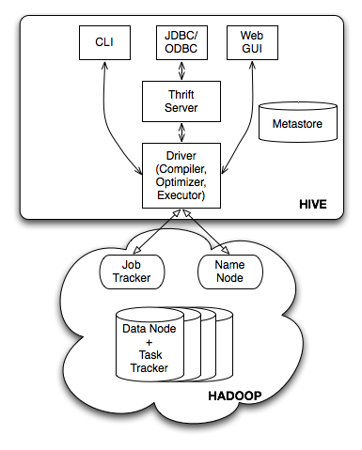
HIVE Architecture

Slide 20
HIVE Components
External Interfaces
User Interfaces both CLI and Web UI and API likes JDBC and ODBC.
Hive Thrift Server
simple client API to execute HiveQL statements
Metastore – system catalog
Driver
Manages the lifecycle of HiveQL for compilation, optimization and execution.

Slide 21
Execution Flow

Slide 22
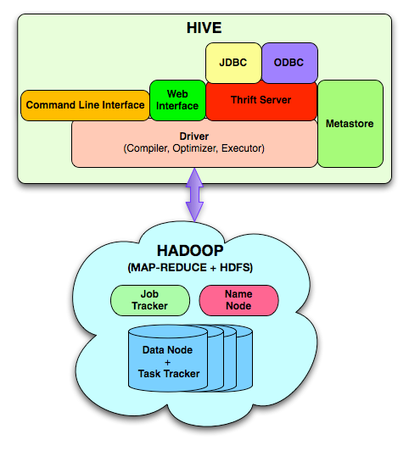
System Architecture and Components

Slide 23
System Architecture and Components
JDBC
ODBC
Web
Interface
Command Line Interface
Thrift Server
Metastore
Driver
(Compiler, Optimizer, Executor)
Metastore
The component that store the system catalog and meta data about tables, columns, partitions etc.
Stored on a traditional RDBMS

Slide 24
System Architecture and Components
JDBC
ODBC
Web
Interface
Command Line Interface
Thrift Server
Metastore
Driver
(Compiler, Optimizer, Executor)
Driver
The component that manages the lifecycle of a HiveQL statement as it moves through Hive. The driver also maintains a session handle and any session statistics.

Slide 25
System Architecture and Components
JDBC
ODBC
Web
Interface
Command Line Interface
Thrift Server
Metastore
Driver
(Compiler, Optimizer, Executor)
Query Compiler
The component that compiles HiveQL into a directed acyclic graph of map/reduce tasks.

Slide 26
System Architecture and Components
JDBC
ODBC
Web
Interface
Command Line Interface
Thrift Server
Metastore
Driver
(Compiler, Optimizer, Executor)
Optimizer
consists of a chain of transformations such that the operator DAG resulting from one transformation is passed as input to the next transformation
Performs tasks like Column Pruning , Partition Pruning, Repartitioning of Data

Slide 27
System Architecture and Components
JDBC
ODBC
Web
Interface
Command Line Interface
Thrift Server
Metastore
Driver
(Compiler, Optimizer, Executor)
Execution Engine
The component that executes the tasks produced by the compiler in proper dependency order. The execution engine interacts with the underlying Hadoop instance.

Slide 28
System Architecture and Components
JDBC
ODBC
Web
Interface
Command Line Interface
Thrift Server
Metastore
Driver
(Compiler, Optimizer, Executor)
HiveServer
The component that provides a trift interface and a JDBC/ODBC server and provides a way of integrating Hive with other applications.

Slide 29
System Architecture and Components
JDBC
ODBC
Web
Interface
Command Line Interface
Thrift Server
Metastore
Driver
(Compiler, Optimizer, Executor)
Client Components
Client component like Command Line Interface(CLI), the web UI and JDBC/ODBC driver.

